Slide 1
FLOW CHART
BY DIBYENDU PAUL

Slide 2
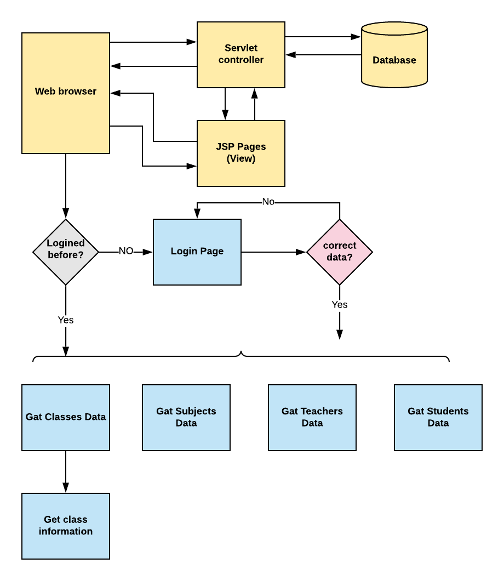
Flow Chart of the Project :

